Slide 1
Employee Data Analysis using Excel
STUDENT NAME: A. NITHYA SRI
REGISTER NO: 122204015
DEPARTMENT: B.com [ corporate secretaryship ]
COLLEGE: SHRI KRISHNASWAMY COLLEGE FOR WOMEN

Slide 2
PROJECT TITLE
Employee Gender Analysis using Excel

Slide 3


AGENDA
Problem Statement
Project Overview
End Users
Our Solution and Proposition
Dataset Description
Modelling Approach
Results and Discussion
Conclusion
3/21/2024 Annual Review

Slide 4

PROBLEM STATEMENT
Numerous workplaces continue to struggle with achieving gender equality. Commonly, there are differences in hiring, advancement opportunities, and pay between male and female workers. Understanding the causes of these differences can assist organizations in creating a more fair and inclusive work setting. By examining employee gender data, organizations can recognize and address potential biases, implement impartial practices, and promote a more diverse and inclusive workforce.

Slide 5

PROJECT OVERVIEW
The study examined gender dynamics within the company's workforce. It gathered and analyzed data on factors like employee distribution across roles and levels, compensation differences, and leadership representation. The goal was to identify any existing gender biases or disparities and develop strategies for a more equitable workplace. The analysis found an equal overall number of male and female employees, but women were underrepresented in certain, especially higher-level, roles. Additionally, there were noticeable pay gaps between male and female employees, with women earning less on average.
.

Slide 6

WHO ARE THE END USERS?
Human resources (HR) professionals are typically the main users of employee gender analysis. They utilize this data to evaluate the gender diversity within the workforce, detect potential biases or imbalances, and develop strategies to foster gender equality. Moreover, senior management may also be interested in this information to comprehend the influence of gender diversity on the organization's culture, productivity, and overall performance.

Slide 7

OUR SOLUTION AND ITS VALUE PROPOSITION
Our tool enables businesses to analyze their workforce's gender composition, detect potential biases, and promote a more equitable workplace. By offering detailed insights into hiring, promotion, and compensation trends, we help companies make data-driven decisions and take proactive actions to address gender disparities. Our value lies in empowering businesses to build a more inclusive and fair environment for all employees. By revealing hidden biases and providing actionable recommendations, we assist organizations in cultivating a culture of equality and enhancing their overall reputation. Our solution not only improves employee satisfaction and retention but also contributes to a more diverse and innovative workforce.

Slide 8
Dataset Description
An employee gender analysis dataset usually includes details like age, time at the company, department, job role, and pay. It may also have information about job performance such as ratings, promotions, and employee turnover. This data can help identify any gender differences in areas like hiring, pay, and career progression. Analyzing this information can give organizations a better understanding of their workplace culture and help them take actions to support gender equality.

Slide 9

THE "WOW" IN OUR SOLUTION
The analysis of employee gender data reveals hidden biases and inequalities. By carefully examining information on hiring, promotions, pay, and performance, we can detect differences that may not be obvious. This allows us to take action to build a fairer workplace where people of all genders have the same chances to thrive.
3/21/2024 Annual Review
9

Slide 10
MODELLING
Analyzing employee gender data using statistical methods can help predict gender-related outcomes like hiring, promotions, and salaries. This can reveal patterns and biases, allowing organizations to take actions to promote gender equality and create a fairer workplace. Common techniques used include regression analysis, decision trees, and machine learning algorithms, which can identify hidden biases and guide targeted improvements.
10

Slide 11
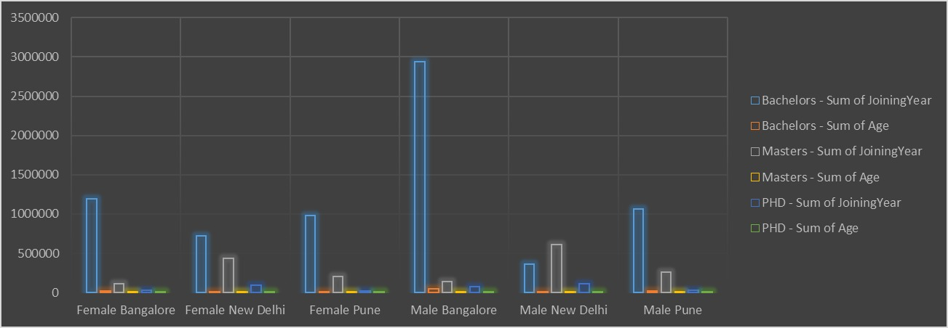
RESULTS
11

Slide 12
conclusion
The examination of employee gender shows a complicated interaction of elements affecting workplace dynamics and results. Although progress has been made towards gender equality, differences continue to exist in areas like pay, representation in leadership positions, and work-life balance. Resolving these issues needs a multi-pronged strategy, such as implementing inclusive hiring procedures, offering equal advancement opportunities, and cultivating a work environment that values diversity and respects all workers.

